Slide 1
Deflection of Beams Using Beam Bending Tables
Superposition
Beam Tables

Slide 2
Example
2a
a
y
A
B
C
y
A
B
C
y
y
A
P
B
C
y
3a-y
y
A
B
P
C
y
A
B
P
C
x

Slide 3
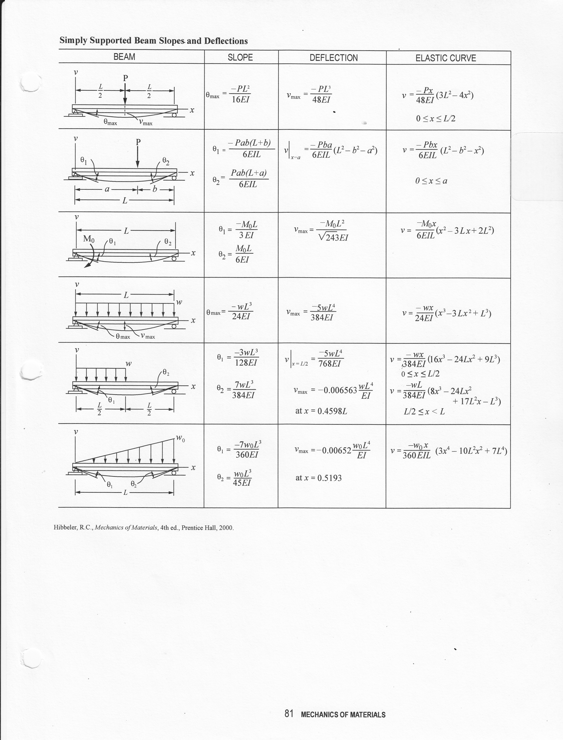
Beam Tables From FE Exam Equation Book: 1
(1)
(2)
(3)

Slide 4
Beam Tables From FE Exam Equation Book: 2
(4)
(5)
(6)

Slide 5
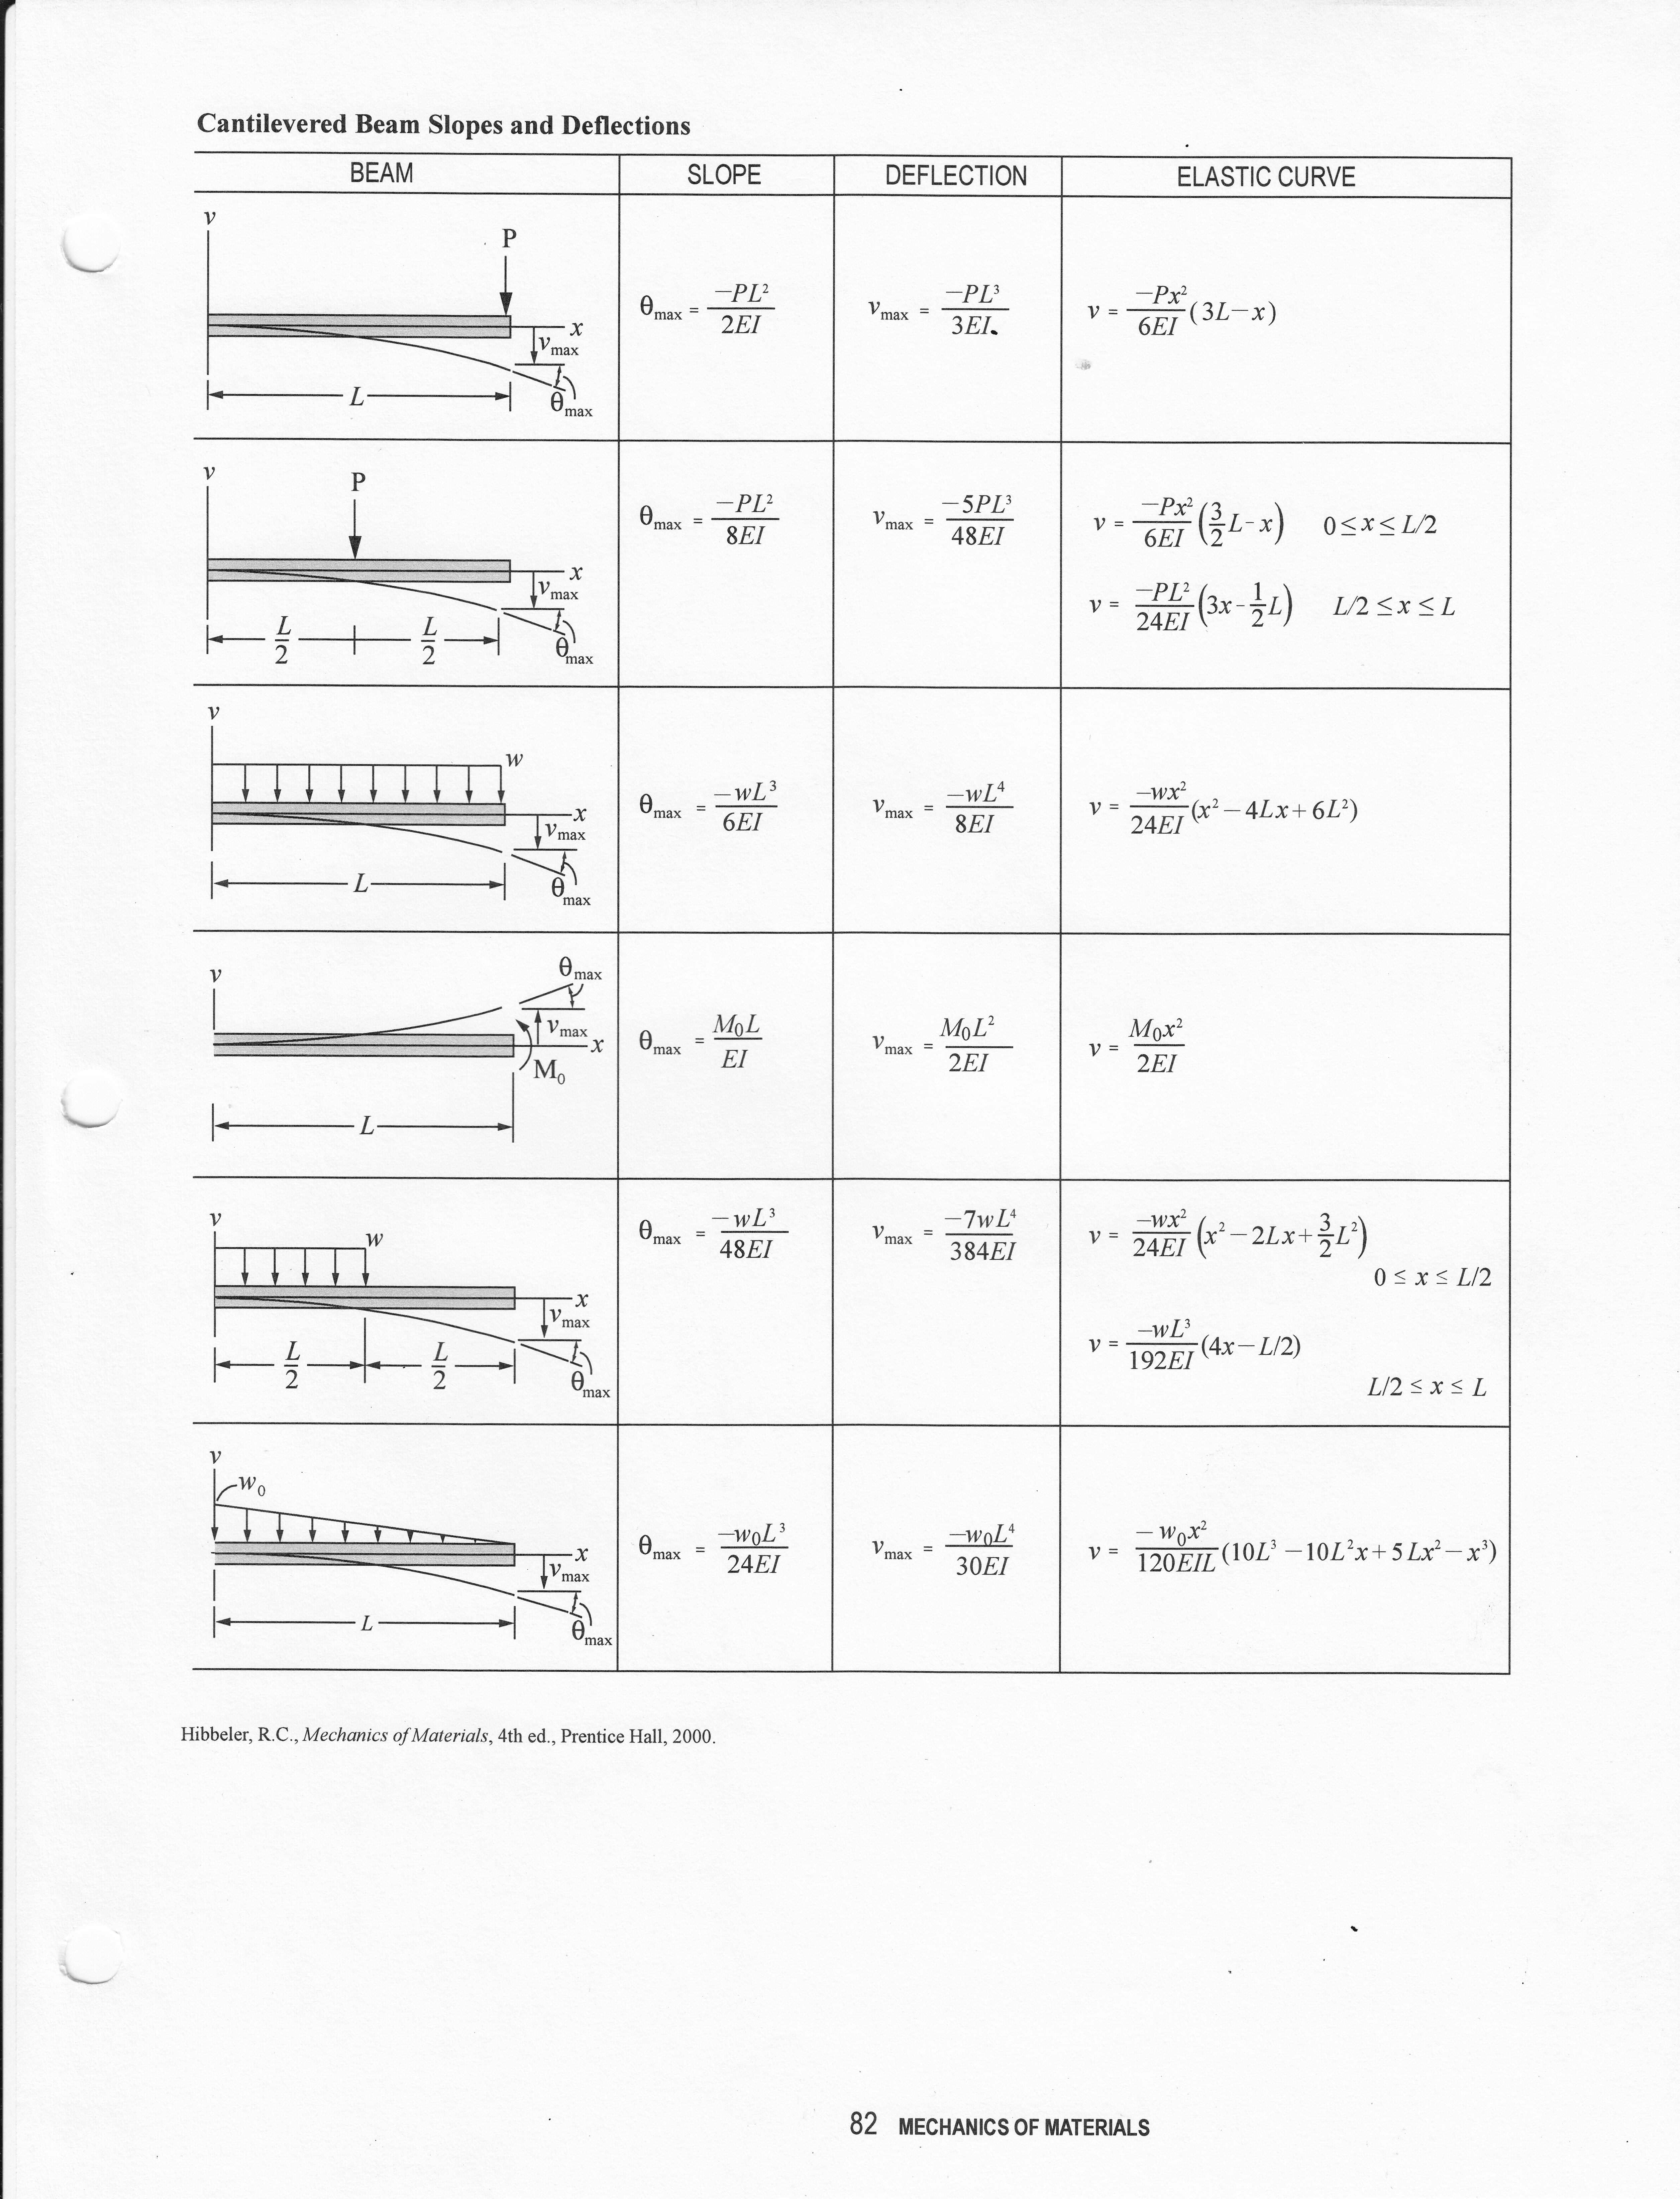
Beam Tables From FE Exam Equation Book: 3
(7)
(8)
(9)

Slide 6
Beam Tables From FE Exam Equation Book: 4
(10)
(11)
(12)

Slide 7
Beams – Statically Indeterminate
10 ft
10 ft
w
(g)
(h)
5ft
5ft
f=8(10³) lb
f=8(10³) lb
w=3(10³) lb/ft
w=3(10³) lb/ft
(i)
(j)
10ft
10ft

